Slide 1
Department of Medicine
Diabetes Clinic
Vascular Unit
Case Presentation
Presented by Prof Aly El Ashmaoui
SSA is a 63 year old male .
Diabetes since 16 years
on insulin therapy
Presented to the diabetes clinic since 18 months
because of multiple ulcers
Of the right foot.

Slide 2
Relevant clinic and investigational data :
Hypertension 170/110
Cardiac evaluation including
Echocardiography:
Abdominal examination including
Ultrasound:
Ischemic cardiomyopathy with CHF
And EF of 13%
Cirrhotic liver with dilated
Portal vein
Laboratory evaluation
Blood Sugar fasting 230 mg/ml
2 hours pp 345 mg/ml
HbA1c 11.5
Urea 51 mg/dl
Creatinine 1.1 mg/dl
Uric acid 6.2
Blood Cholesterol 322 mg/ml
triglyceride 231 mg/ml
Hg 9.5 g/dl
WBCs 12,000
With shift to the left
SGPT 87 unit
SGOT 57 unit
INR 1.8
Culture from wound :
- Staph aureus
Coagulase positive
- Pseudomonas
Hepatitis C antibody was positive

Slide 3
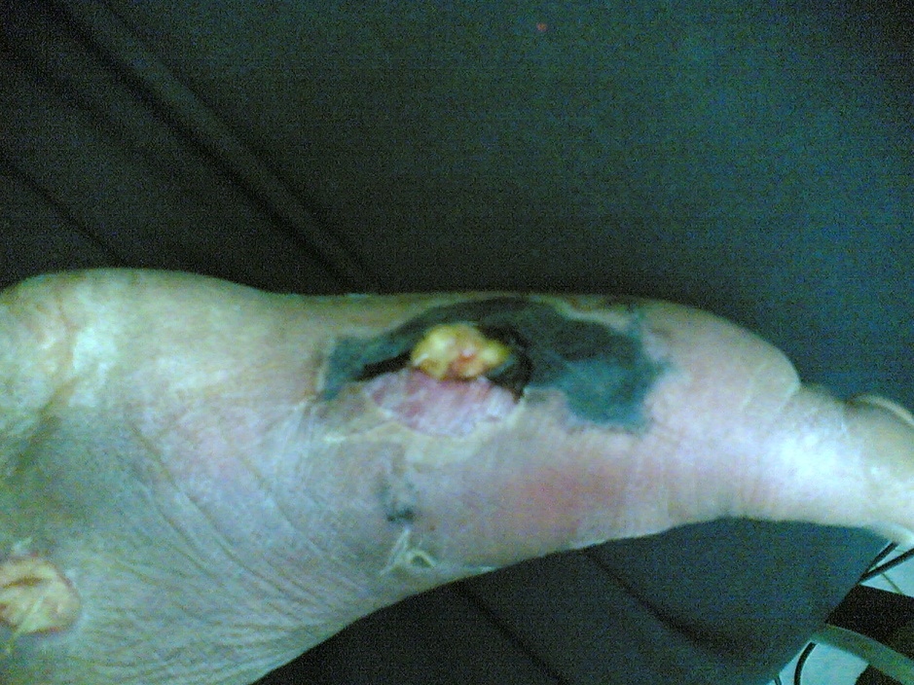
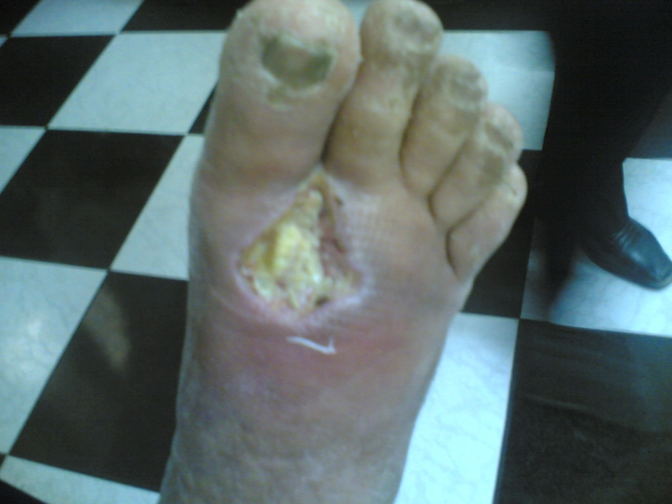
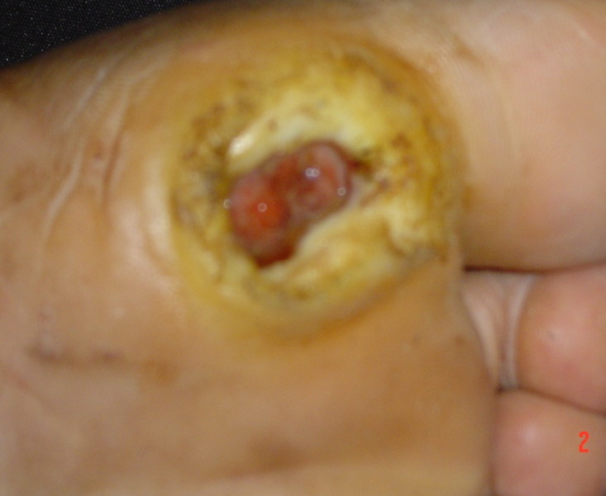
Right Foot
Right Foot
Left Foot

Slide 4
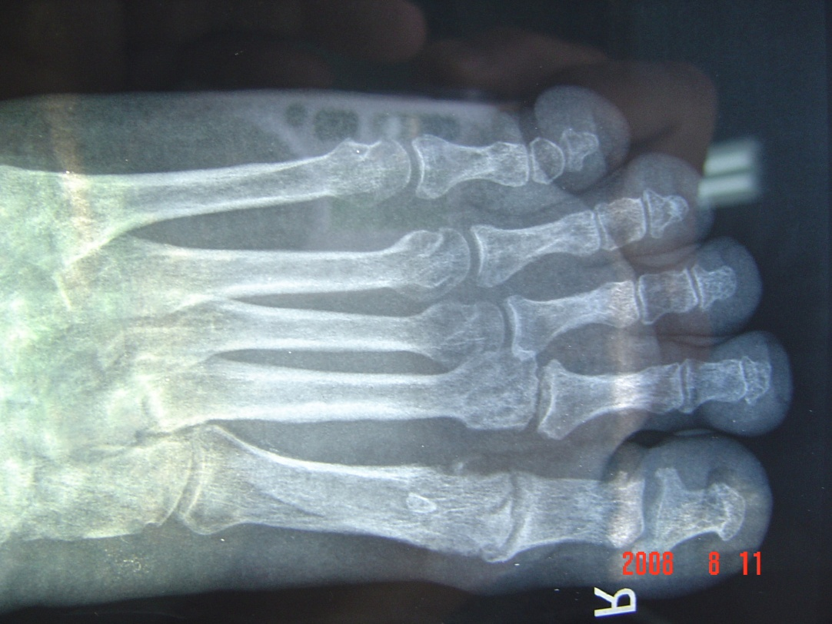
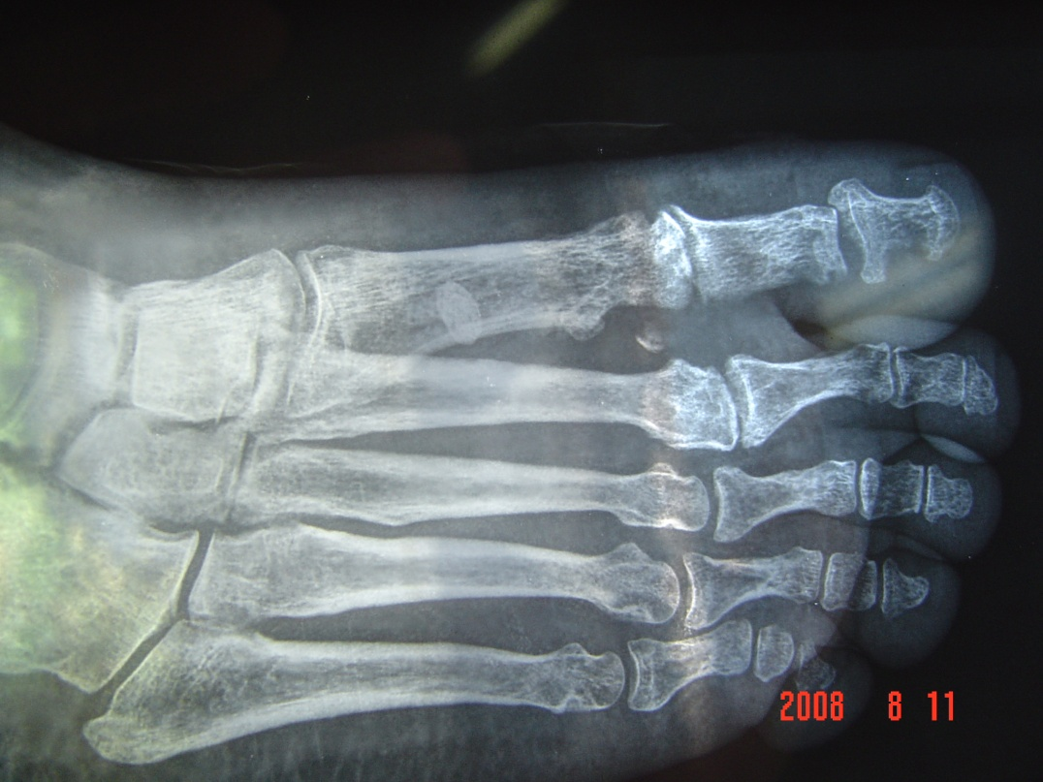
Plain X ray Foot was normal

Slide 5
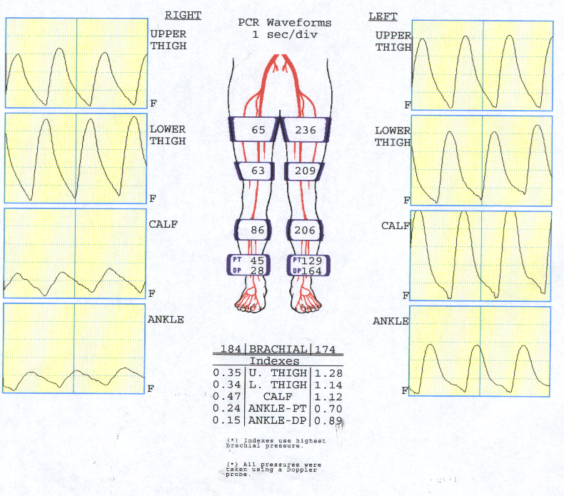
Hemodynamic evaluation of the vascular tree
Digital plethysmography was severely affected on the right side
Toe pressure of 12 mm Hg
Transcutaneous O2 at 40 C = 17 mm hg

Slide 7
Management
Blood pressure was controlled with
Coversyl 4 mg
Norvasc 5 mg
Natrilix SR one tablet
Blood sugar was controlled with Actrapid /8 hours
Other drug were added :
Effox 20 mg/12 hours
Vastarel MR /12 hours
Clexan 40/12 hours
Clindamycin and Tavanic 500 mg ( added according to culture)

Slide 8
After Two week of satisfactory control of the
Medical condition:
A decision to revascularise the limb
Due to the presence of clear evidence
Of critical leg ischemia

Slide 9
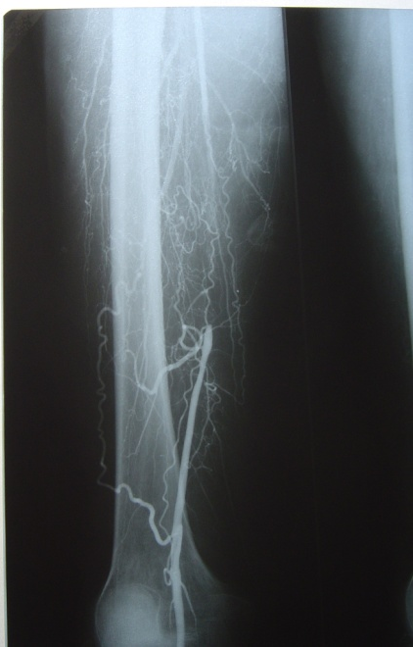
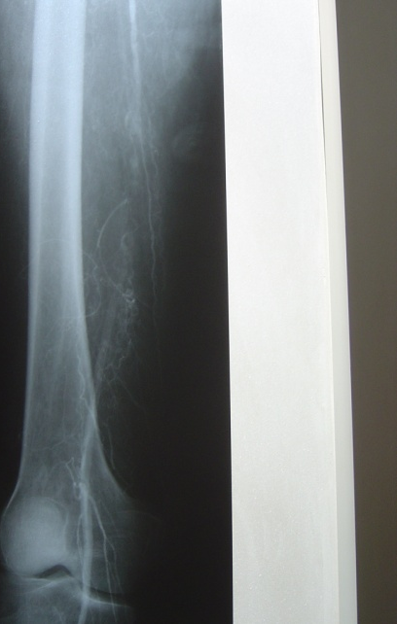
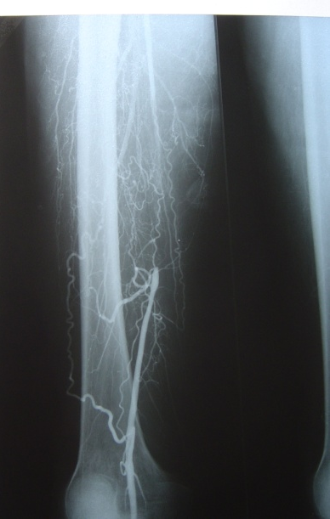
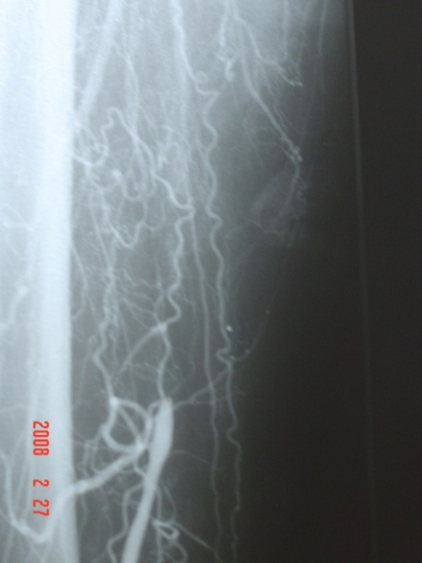
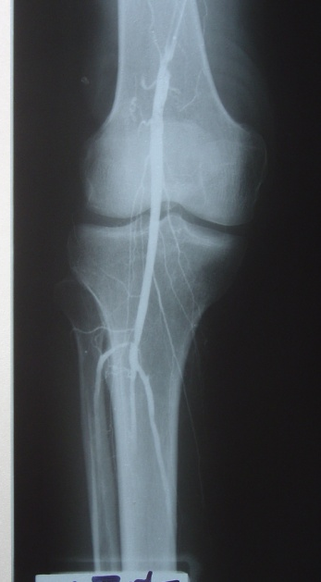
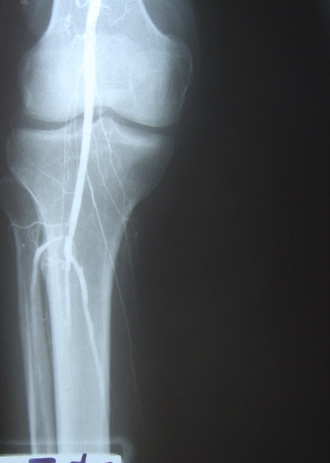
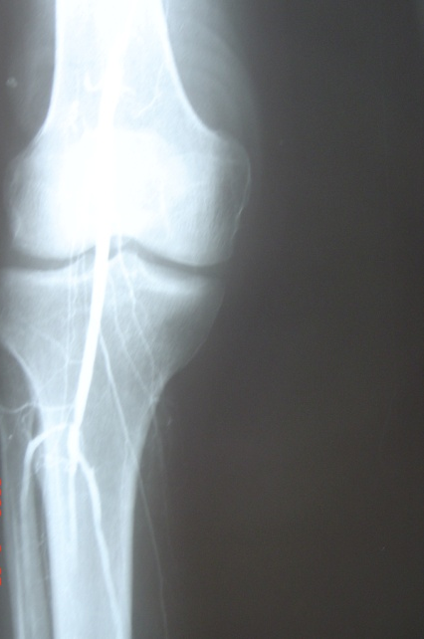

Slide 10
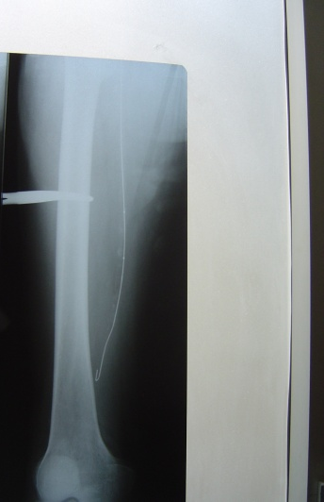
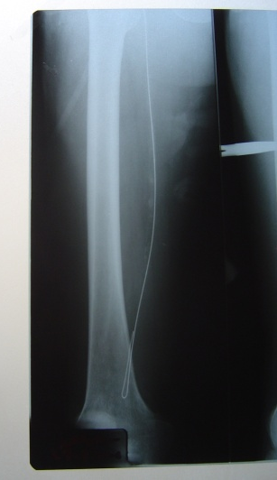
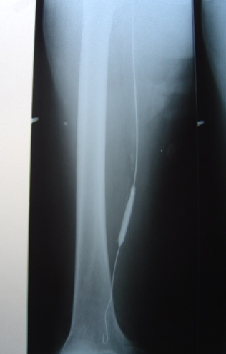
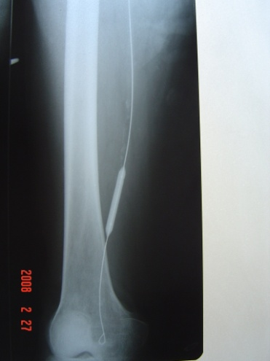
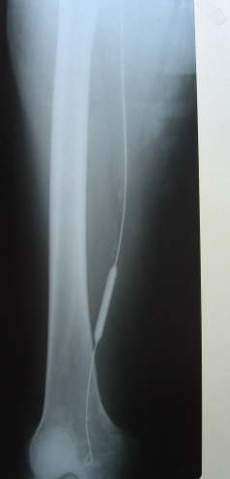
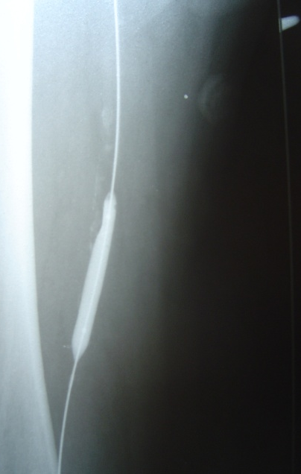
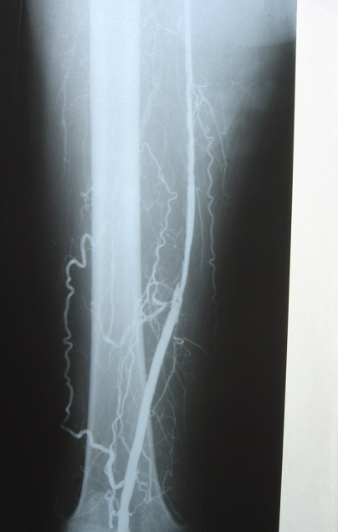
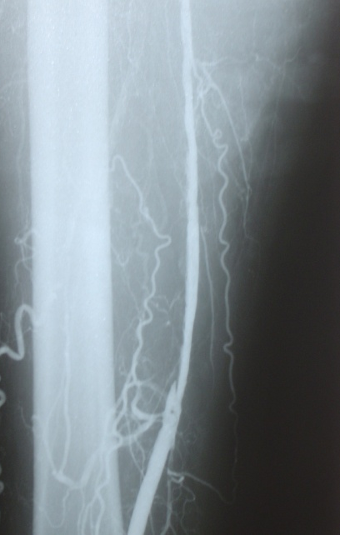
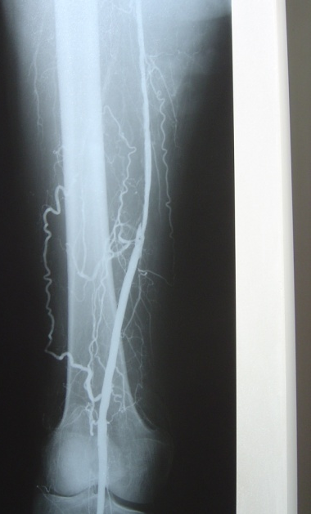

Slide 12
Post PTA Hemodynamic evaluation
Ankle/Brachial index on the right side =0.7
Toe pressure 56 mm Hg
TcpO2 at 40 c = 74 mm Hg

Slide 13
Following successful angioplasty
(Anatomical and hemodynamic)
Clexan was elevated to 80 mg/12 hours for 3 months
Plavix was added

Slide 14
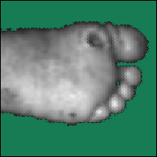
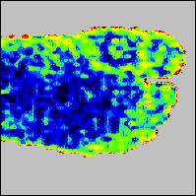
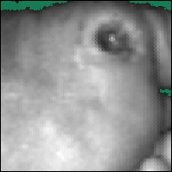
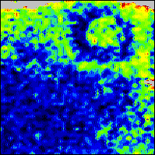
Care of the wounds

Slide 15
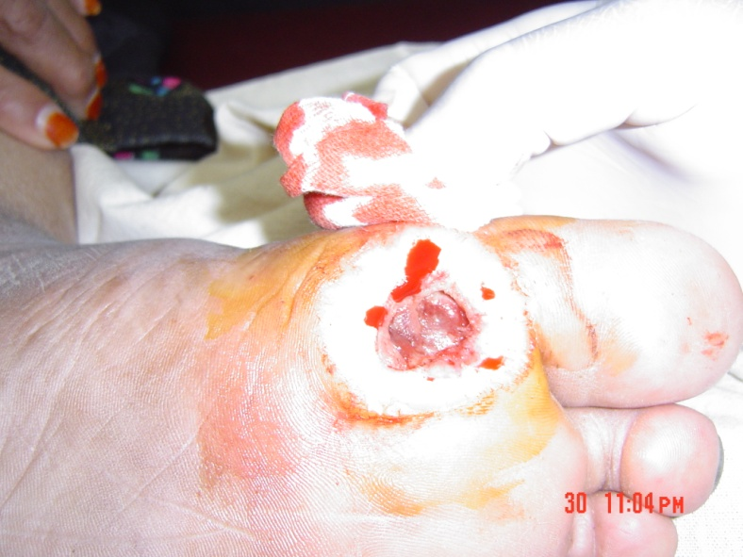
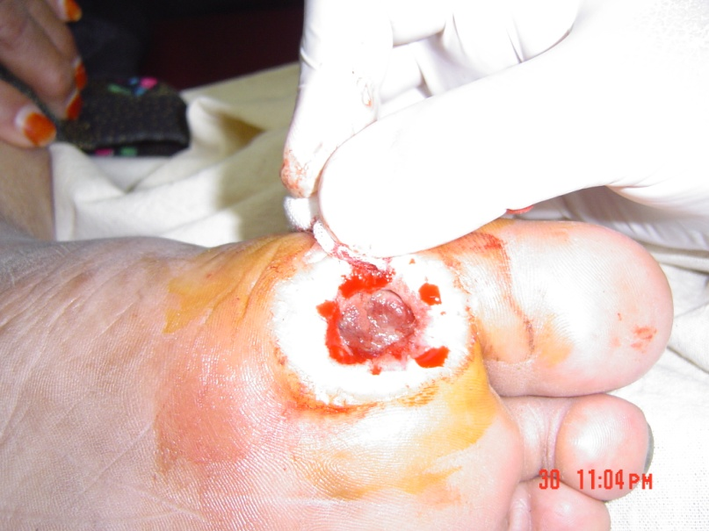
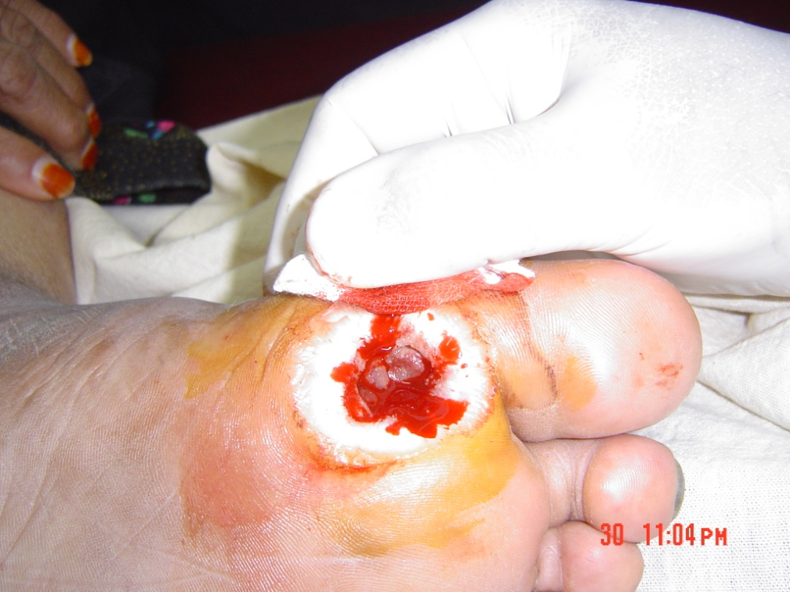

Slide 16
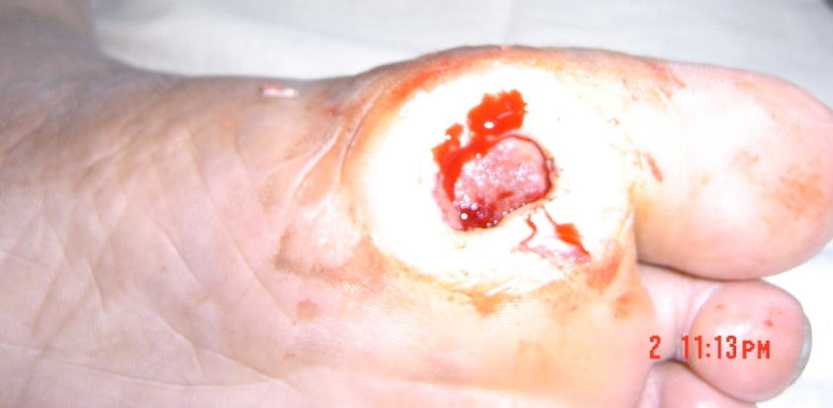
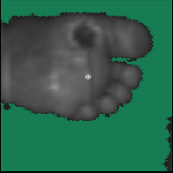
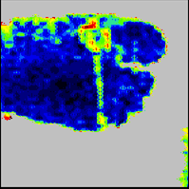

Slide 17
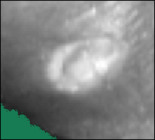
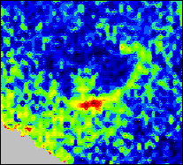
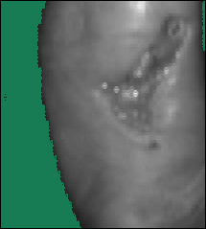
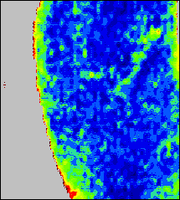

Slide 18
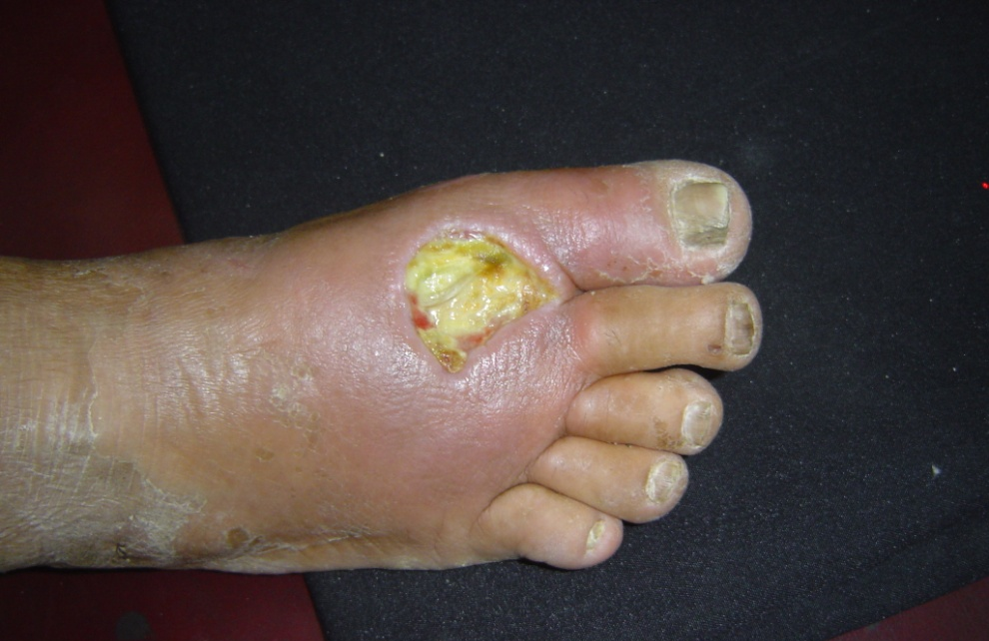
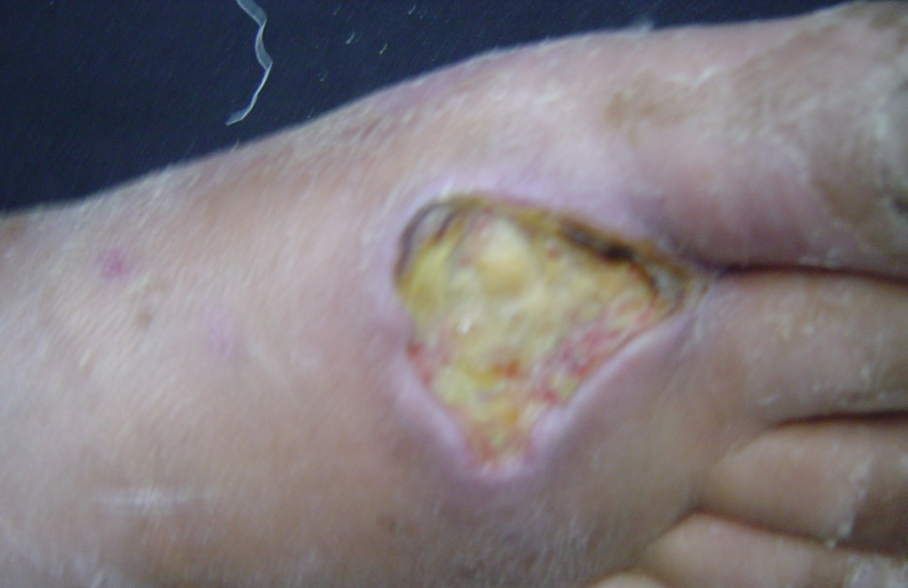

Slide 19
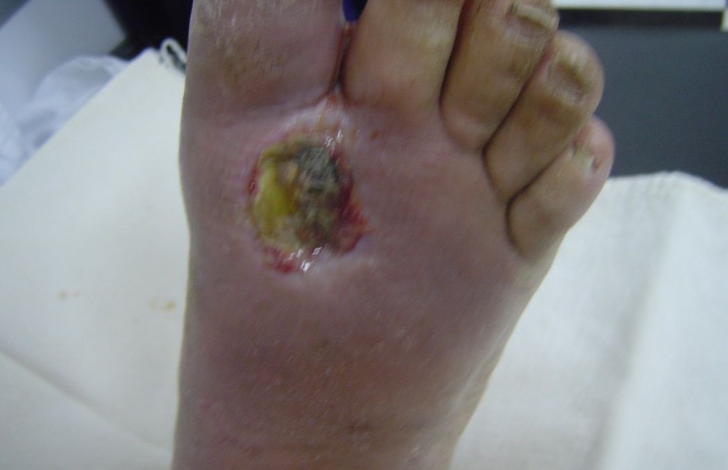
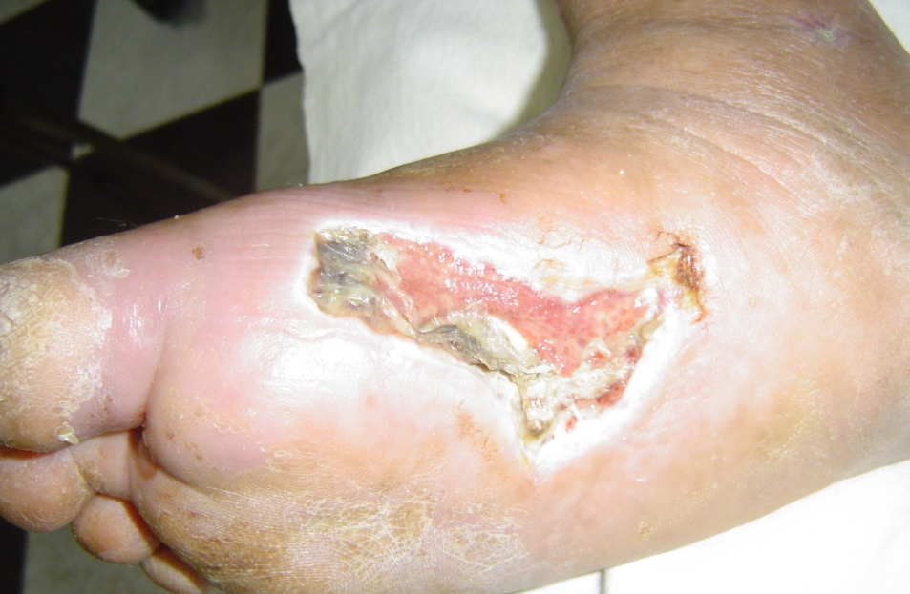
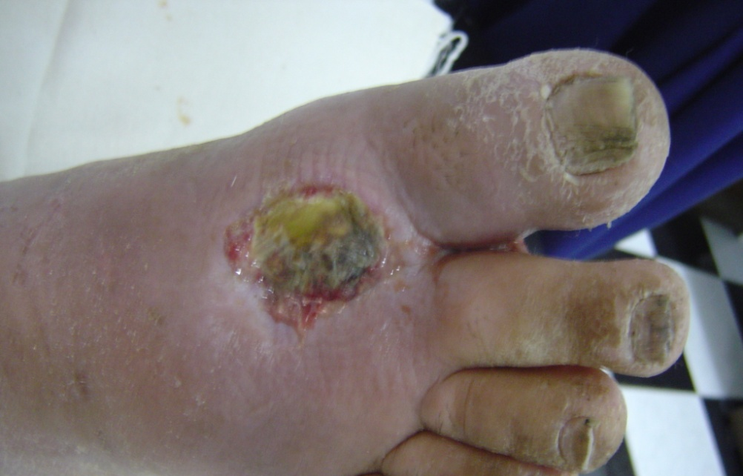
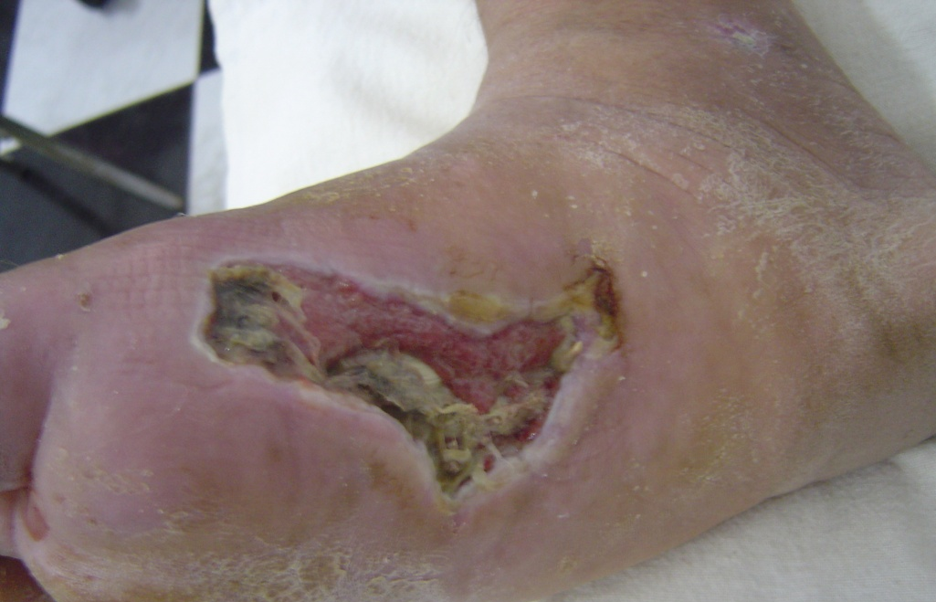

Slide 20
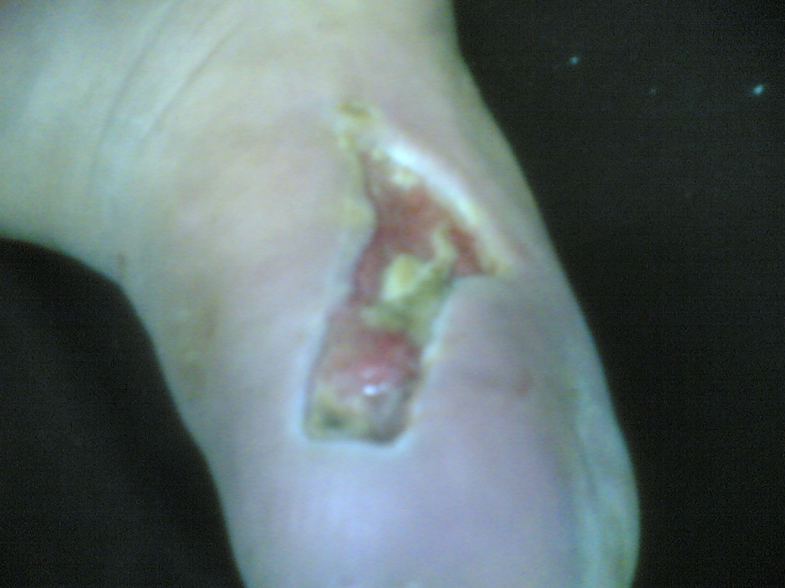
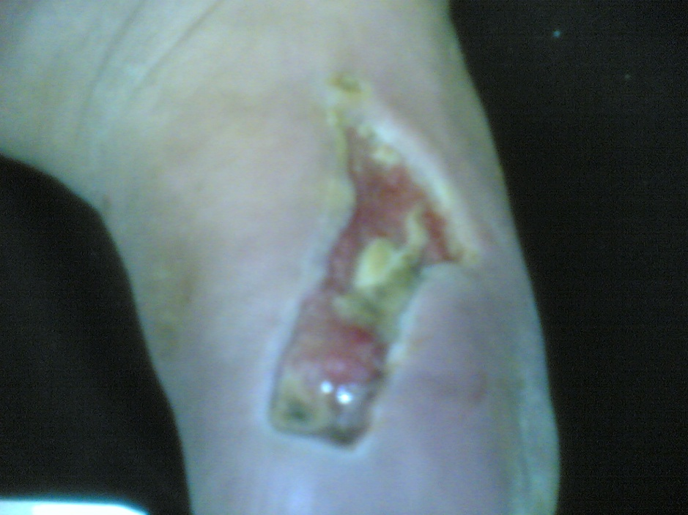

Slide 21
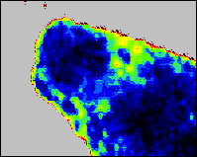
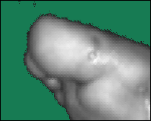

Slide 22
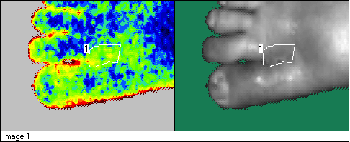

Slide 23
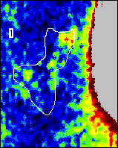
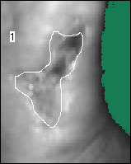

Slide 24
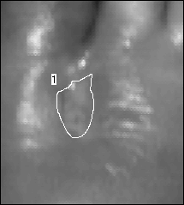

Slide 27
Aspirated
Serous
Fluid

Slide 28
Follow up of the patient was done
Every 2 months
A specially designed diabetic foot with
Diabetic insole was applied
No oral anticoagulation was given
Last study on 24/02/2016
Ankle /Brachial index on the right side 0.78
on the left side 0.86
tcpO2 on the right side 89 mm Hg
HbA1c 7.4
EF 26%
Liver enzymes remained 2-3 fold elevated

Slide 29
Registered Diabetic foot referred to the center of Diabetes and endocrinology
Cairo University Hospital
From November 2009 to October 2012
211 cases
24 cases
Angioplasty
8 cases
amputation
6 cases
Bypass
173 cases
conservative
3 cases
Toe amputation
2 cases
Mid tarsal
amputation
3 cases with below knee
amputation
2 cases
With stenting
22 cases
With no stenting

Slide 30
Recommendation from the vascular Medicine group
More integration with the department of Surgery
?? Special dedicated group
?? Micro vascular surgery
Integration with other departments:
Neurophysiology
Physiology
Orthopedic Surgery
Physical Medicine and rehabilitation
Introduction of the foot pressure detection devices ( in process)
Recording of Data including follow up and repeated
Hemodynamic evaluation

Slide 31
Special thanks

